Slide 1
Intro Stats
Brian Stock
03.25.17

Slide 2
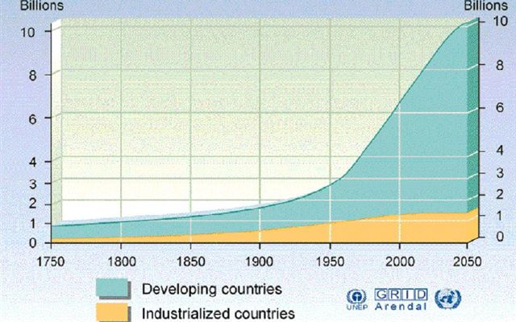
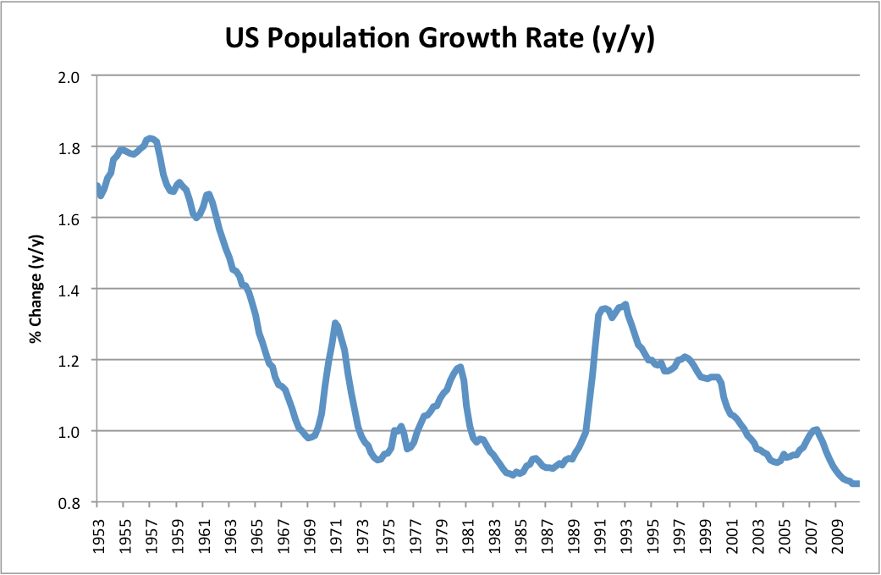
Goals of statistics
Estimate the values of important parameters
Test hypotheses about those parameters
“What is the global population growth rate?”
“Is the US pop growth rate declining?”

Slide 3
Check 1. Parameters vs. estimates
Write on a piece of paper:
What is the difference between a parameter and an estimate?
What is the difference between a population and a sample?
What makes a sample good?
Individually
1-2 minutes

Slide 4

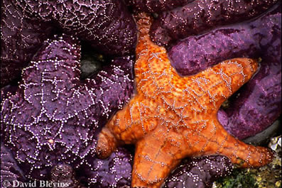
A population of starfish
What parameters may we be interested in?
Notes:
4
These represent Pisaster ochraceus, a species with a color polymorphism that live in the northeast Pacific.
Mean size
Orange vs. purple proportion
Are orange bigger than purple?

Slide 5
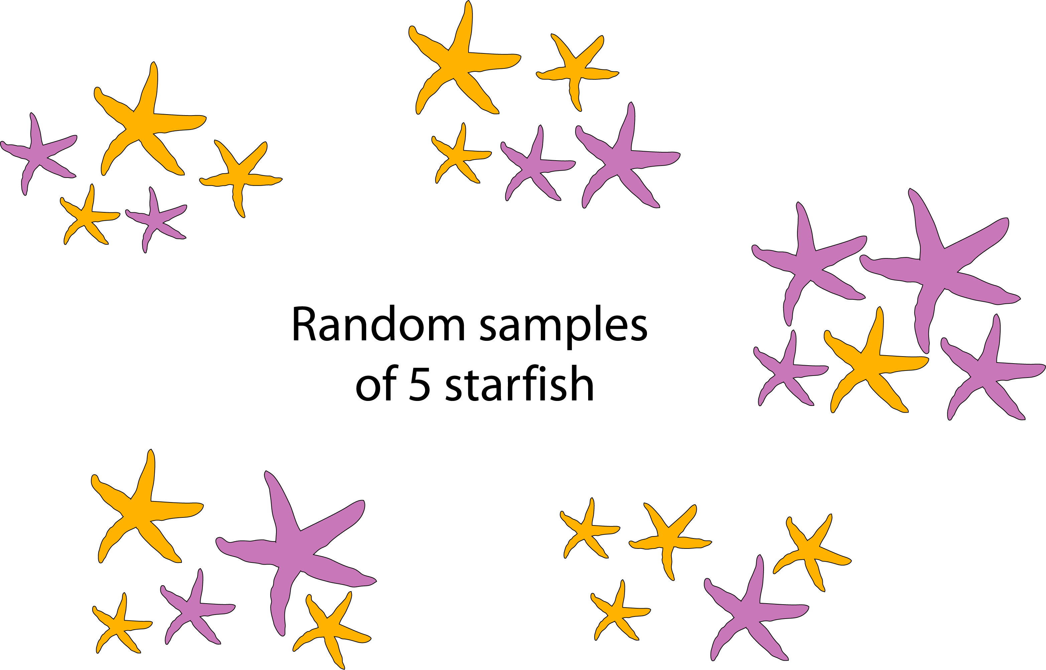
Samples of starfish population
How do our estimates vary by each sample?
Notes:
5
We can’t measure EVERY starfish
Each of these was randomly generated from the previous slide.
Most get a pretty good picture of the mean size and proportion of orange and purple, but the top left is too small, and the rightmost one is too large. Similarly for the proportion purple.

Slide 6
Populations --- Parameters
Constant/fixed
Samples --- Estimates
Random variables
Want to know
What we have
Notes:
6
Mnemonic device

Slide 7

Populations --- Parameters
Constant/fixed
Samples --- Estimates
Random variables
Want to know
STATISTICS
What we have
Notes:
7
Mnemonic device

Slide 8
What makes a good sample?
Notes:
Ask for responses

Slide 9
What makes a good sample?
Independent selection of individuals
Random selection of individuals
Each individual has equal chance of being selected
Sufficiently large

Slide 10
Sample bias vs. precision
Notes:
10
What is the yellow/center? Population parameter
What are the dots? Sample estimates
We want an estimation procedure like the top left with no bias and hi precision. Define bias and precision

Slide 11
The Stumbling Blocks
What statistical test should I use?
How to do it (using R)
STATISTICS
Notes:
Most difficult part of statistics class: I’ve learned a bunch of tests – which one do I use?
Need to clarify a few things first…

Slide 12
Check 2. Scientific method / process
In groups of 4, discuss:
What are the steps in the scientific method/process?
Choose a simple biological question. Describe the steps you would take to find the answer.
~10 minutes
Share with class

Slide 13
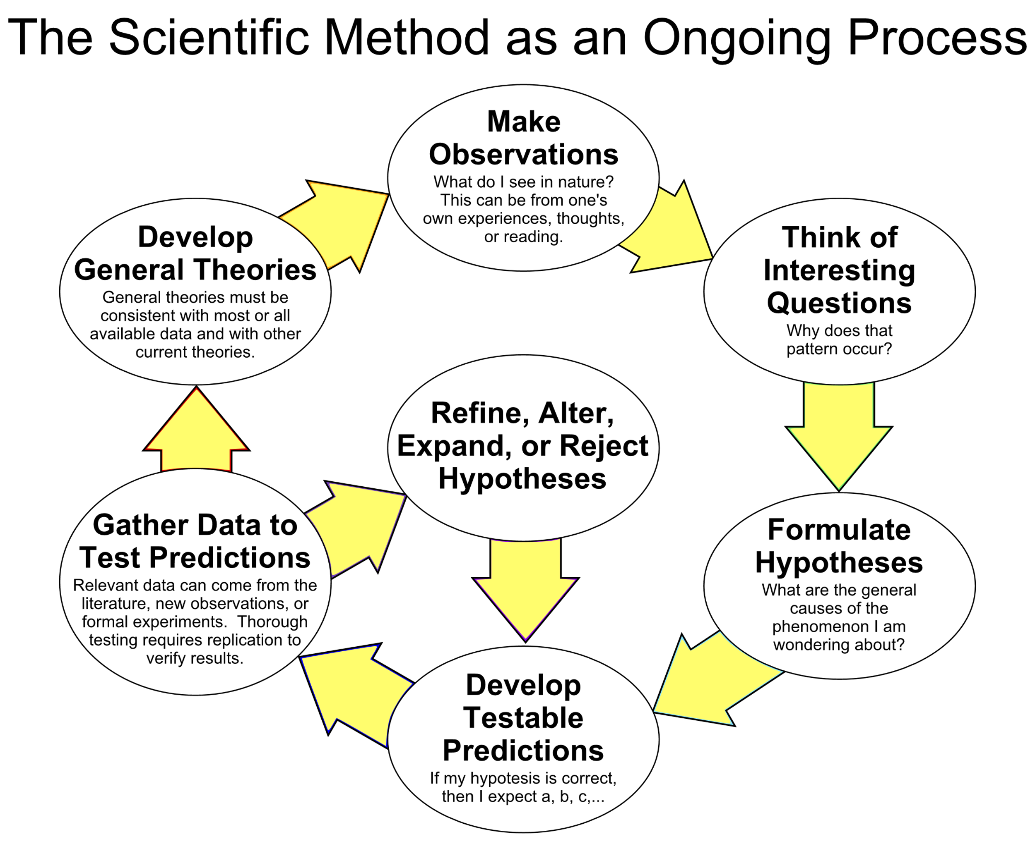
Scientific method / process
By ArchonMagnus - Own work, CC BY-SA 4.0, https://commons.wikimedia.org/w/index.php?curid=42164616

Slide 14
Biological question. Be specific!
Put the question in the form of a biological null hypothesis and alternate hypothesis.
Translate the biological hypotheses into statistical hypotheses
Which variables are relevant to your question?
Determine what kind of variable each one is.
Design an experiment that controls or randomizes the confounding variables.
Choose the best statistical test to use. Depends on:
number of variables
kinds of variables
expected fit to the parametric assumptions
hypothesis to be tested
Determine a good sample size for the experiment. Power analysis.
Collect data (do the experiment).
See if your data meet the assumptions of the statistical test you chose. If it doesn’t, choose a more appropriate test.
Apply the statistical test, and interpret the results.
Communicate your results, often with a graph or table
p.3 McDonald Biostatistics

Slide 15
Check 3. Null vs alternate hypotheses
Did your group list null and alternate hypotheses?
If not, do so now
Groups
1-2 minutes
Notes:
Biological question
Biological null vs. alternate
Statistical null vs. alternate

Slide 16
Check 4. Hypothesis testing
Population
Define our population parameter of interest.

Slide 17
Check 4. Hypothesis testing
Population
We can’t measure EVERY starfish in the population. Instead, take a random sample. Calculate the estimate using our sample.
Sample

Slide 18
Check 4. Hypothesis testing
Population
Sample
Sample
But our sample/estimate is random – imagine all of the other samples we COULD have gotten!
Sample
Sample
Sample
Sample
Sample
Sample
Sample

Slide 19
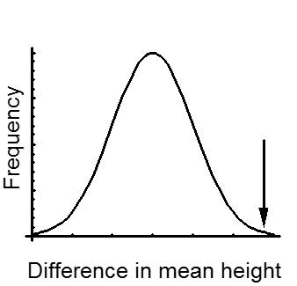
Check 4. Hypothesis testing
Population
If we make an estimate (ex: calculate mean) from each of these samples, we have the sampling distribution under the null hypothesis.
Sample
Sample
Sample
Sample
Sample
Sample
Sample
Sample
Sample

Slide 20
Check 4. Hypothesis testing
Population
If our sample is very different from what we expect under the null hypothesis, (calculate the probability, or p-value) then we reject the null (conclude that our population parameter is different).
Sample
Sample
Sample
Sample
Sample
Sample
Sample
Sample
Sample
Sample

Slide 21
Check 4. Hypothesis testing
Population
If our sample is very different from what we expect under the null hypothesis, (calculate the probability, or p-value) then we reject the null (conclude that our population parameter is different).
Sample
Sample
Sample
Sample
Sample
Sample
Sample
Sample
Sample
Sample
p = 0.01

Slide 22
Check 4. Hypothesis testing
Population
If our sample is not different from what we expect under the null hypothesis, (calculate the probability, or p-value) then we fail to reject the null (conclude that our population parameter is not different).
Sample
Sample
Sample
Sample
Sample
Sample
Sample
Sample
Sample
Sample

Slide 23
Check 4. Hypothesis testing
Population
If our sample is not different from what we expect under the null hypothesis, (calculate the probability, or p-value) then we fail to reject the null (conclude that our population parameter is not different).
Sample
Sample
Sample
Sample
Sample
Sample
Sample
Sample
Sample
Sample
p = 0.48

Slide 24
STRETCH!

Slide 25
Check 5. Types of data
Time series
Count/discrete
Paired
Continuous
Categorical
Ordinal
Binomial
3) At a port, you track the number of every species of fish caught by the fishermen every day for 3 months
Fecha | Mero | Manta | Pargo | Mojarra
03.06.17 | 25 | 0 | 67 | 18
04.06.17 | 34 | 2 | 55 | 17
05.06.17
06.06.17
How could you display the data?
Notes:
Go over exam questions 3-8

Slide 26
Check 5. Types of data
Time series
Count/discrete
Paired
Continuous
Categorical
Ordinal
Binomial
4) Beaufort sea state
Beaufort state | Wind speed | Wave height | Description
0 | < 1 | 0 | mirror-like
1 | 1-5 | 0-0.2 | ripples
2 | 6-11 | 0.2-0.5 | wavelets
3 | 12-19 | 0.5-1 | crests break
4 | 20-28 | 1-2 | whitecaps
5 | 29-38 | 2-3 | spray
6 | 39-49 | 3-4 | foam crests
How could you display the data?
Notes:
Go over exam questions 3-8

Slide 27
Check 5. Types of data
Time series
Count/discrete
Paired
Continuous
Categorical
Ordinal
Binomial
5) For one fishing port in 2012 and 2013 you have the total number of fish caught. You want to see if there is a difference between 2012 and 2013.
Year | Catch
2012 | 2168
2013 | 3087
How could you display the data?
Notes:
Go over exam questions 3-8

Slide 28
Check 5. Types of data
Time series
Count/discrete
Paired
Continuous
Categorical
Ordinal
Binomial
6) You study a population of grouper and collect length measurements of 500 fish
Fish | Length (mm)
1 | 466
2 | 680
3 | 512
…
500 | 717
How could you display the data?
Notes:
Go over exam questions 3-8

Slide 29
Check 5. Types of data
Time series
Count/discrete
Paired
Continuous
Categorical
Ordinal
Binomial
7) During a species’ spawning season, you sample 200 females and record whether or not each female has eggs (sexual maturity)
Female | Mature?
1 | Yes
2 | No
3 | No
…
200 | Yes
How could you display the data?
Notes:
Go over exam questions 3-8

Slide 30
Check 5. Types of data
Time series
Count/discrete
Paired
Continuous
Categorical
Ordinal
Binomial
8) On a fishing boat, you record the species of each fish caught.
Fish | Species
1 | Manta
2 | Mero
3 | Pompano
…
200 | Pargo
How could you display the data?
Notes:
Go over exam questions 3-8

Slide 31
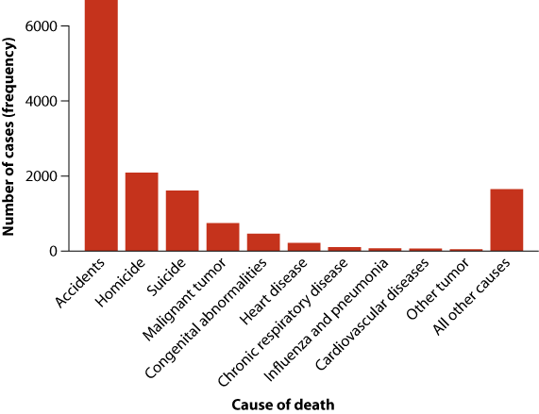
Notes:
31
Bars graph – Categorical data.

Slide 32
Bar graph
Notes:
32
Bars graph – Categorical data.

Slide 33
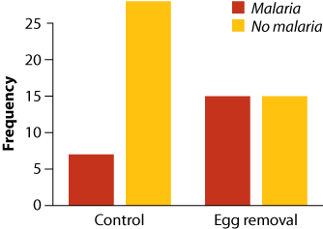

Slide 34
Grouped bar graph

Slide 35
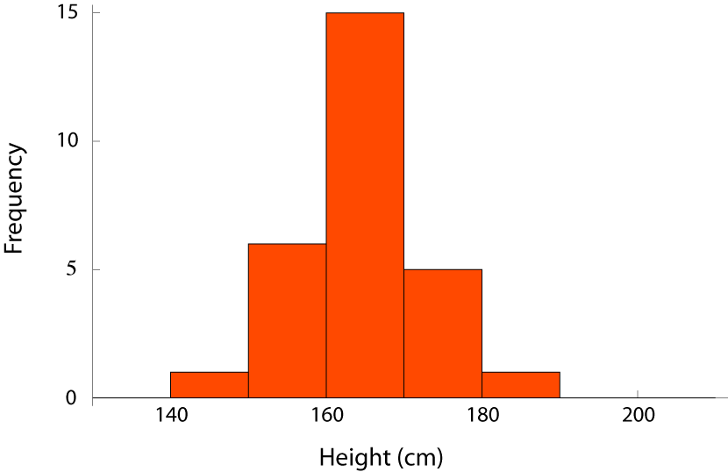

Slide 36
Histogram

Slide 38
Histograms

Slide 39
Cumulative
frequency

Slide 40
Cumulative Distribution
What is the median height?
What percent of students are less than 180 cm? 210 cm?
If I am 160 cm tall, what percentile am I?

Slide 41
Cumulative Distribution vs. Probability Distribution
Frequency
The cumulative frequency =
proportion of individuals equal to or less than that value

Slide 42
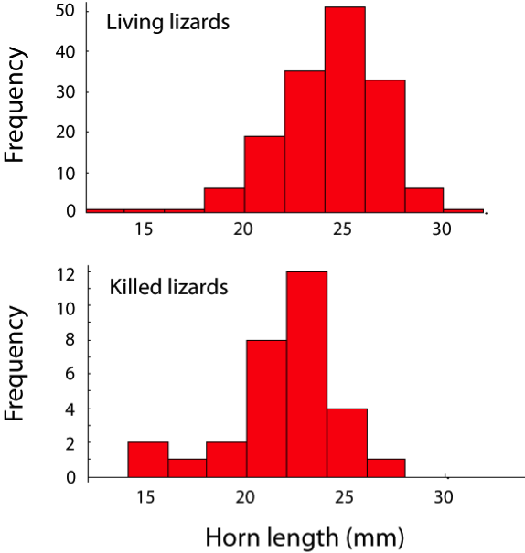
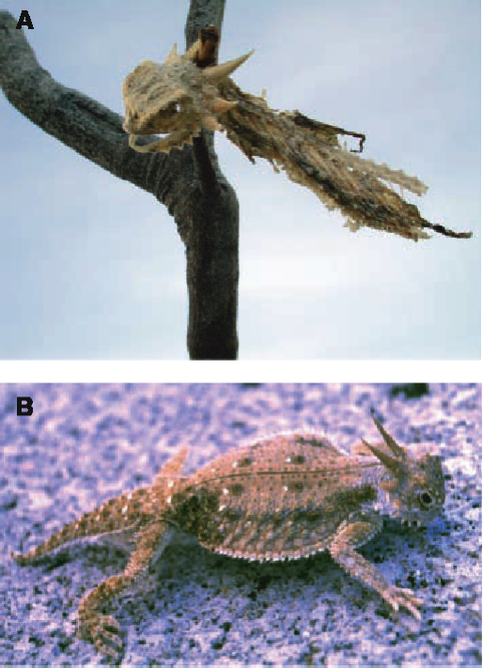
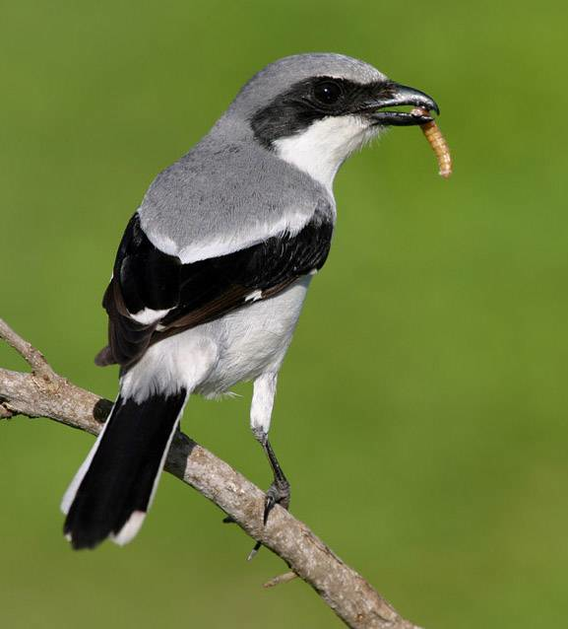
Multiple histograms
Shrike
Young, K. V., E. D. Brodie Jr., and E. D. Brodie III. 2004. How the horned lizard got its horns. Science 304:65.
www.netcore.ca/~peleetom
Notes:
42
These are measurements of the horn sizes for horned lizards which were either captured alive or found dead after being killed by shrikes.
Young, K. V., E. D. Brodie Jr., and E. D. Brodie III. 2004. How the horned lizard got its horns. Science 304:65.

Slide 43
Two ways of comparing 4 distributions
^{Beall et al. (2002)}

Slide 44
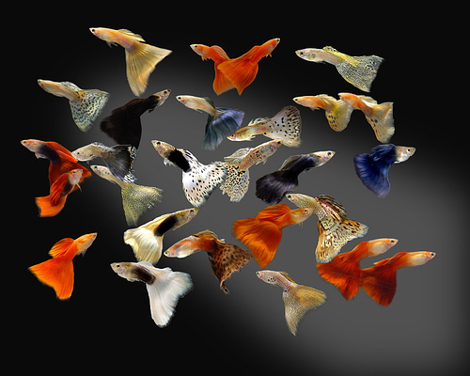
^{Brooks 2000}
Notes:
44
Snakes warm up to digest their food.

Slide 45
Scatter plot
^{Brooks 2000}
Notes:
45
Snakes warm up to digest their food.

Slide 46
Check 7. Describing Distributions
Center
Mean
Median
Mode
Width
Range
Standard deviation (SD)
Variance
Coefficient of variation (CV)

Slide 47
Range

Slide 48
Variance in a population
N is the number of individuals in the population.
μ is the true mean of the population.
Notes:
Why is it squared?

Slide 49
Sample variance
n is the sample size
Notes:
4 differences from population mean:
s^2 instead of sigma^2;
uses sample size instead of population size,
taken as deviations from sample mean rather than population mean (which is not available);
n-1, to account for bias caused by using Ybar (which is slightly closer to the individuals in the sample than the true mean is, because the sample mean is calculated from the sample too

Slide 50
Standard deviation (SD)
Positive square root of the variance
σ = true standard deviation
s = sample standard deviation:
Notes:
Variance measures the mathematical dispersion of the data (useful for additional mathematics but not so useful in a real-world sense). Standard Deviation is expressed in the same units as the data, and therefore gives a useful measure of the ‘spread’ of the data.

Slide 51
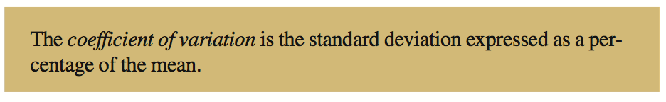
Coefficient of variation (CV)
Why calculate CV?

Slide 52
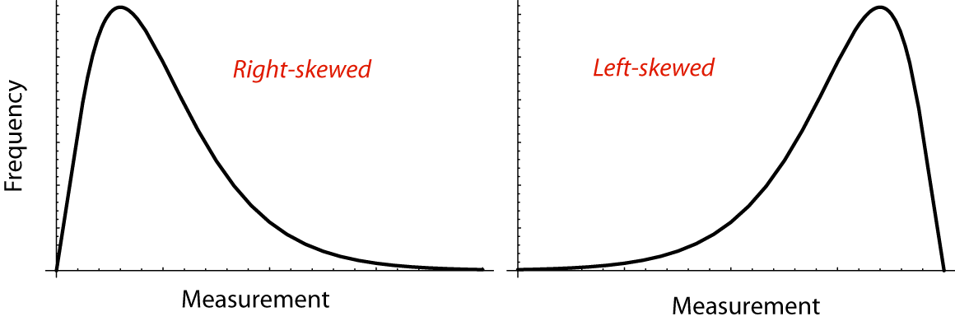
What have we missed by only talking about center and width?

Slide 53
Skew
Measure of asymmetry
Skew direction refers to the pointy tail of a distribution

Slide 54
Skew
Measure of asymmetry
Skew direction refers to the pointy tail of a distribution

Slide 55
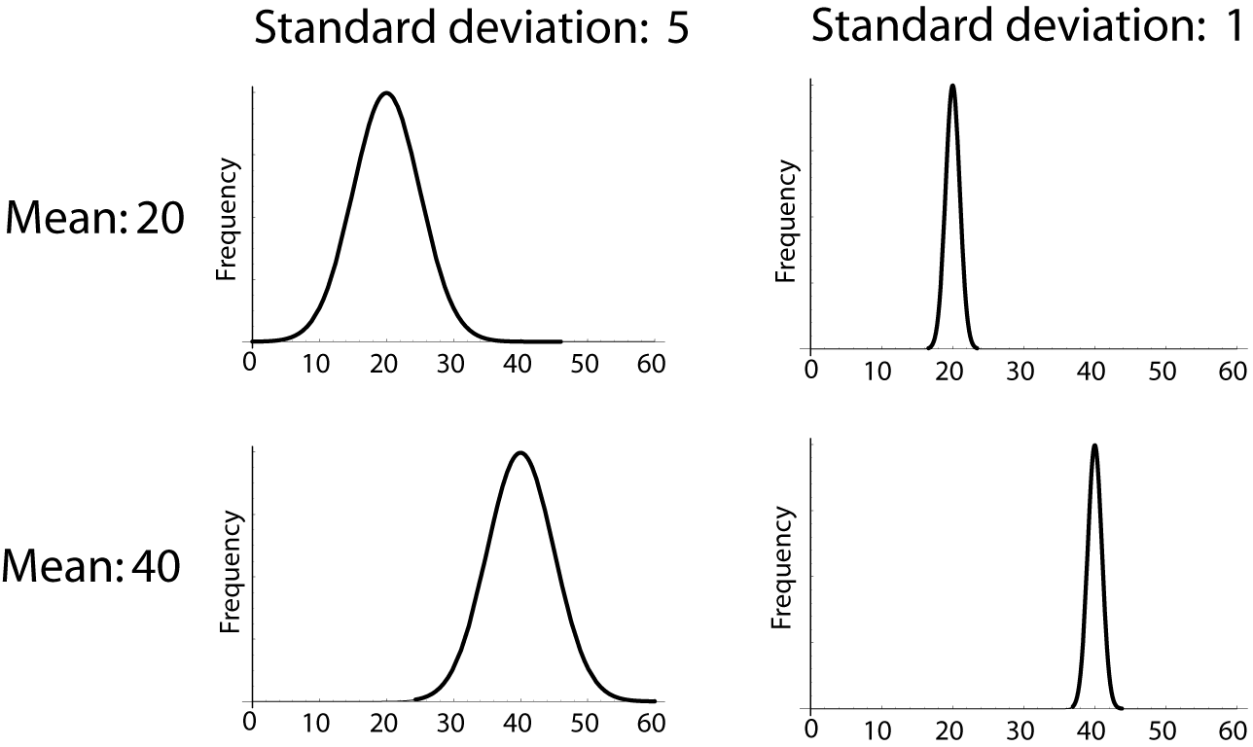
Check 8. Normal distribution
Describe these normal distributions

Slide 56
Check 8. Normal distribution
N (mean, sd)
N (20,5)
N (20,1)
N (40,5)
N (40,1)

Slide 57
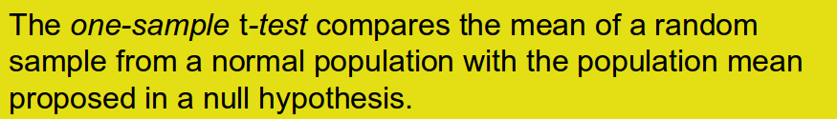
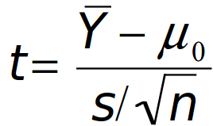
Check 9. t distribution

Slide 58
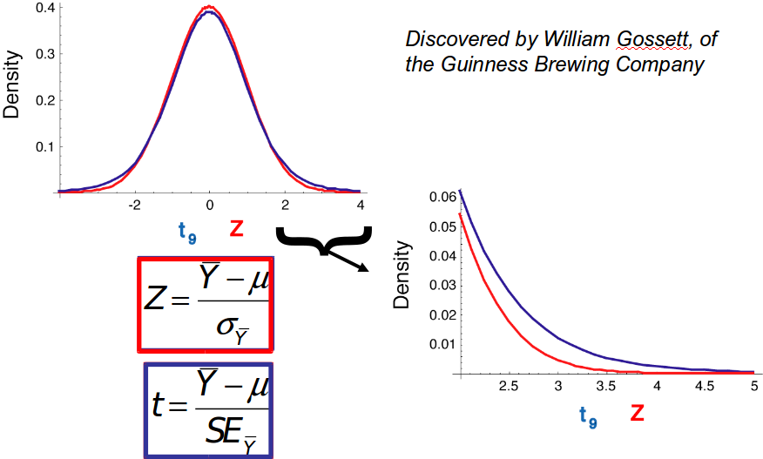
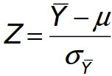
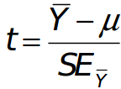
Check 9. t distribution
How is a t-distribution different from a normal distribution?

Slide 59
Check 9. t distribution
How is a t-distribution different from a normal distribution?

